Slide 1
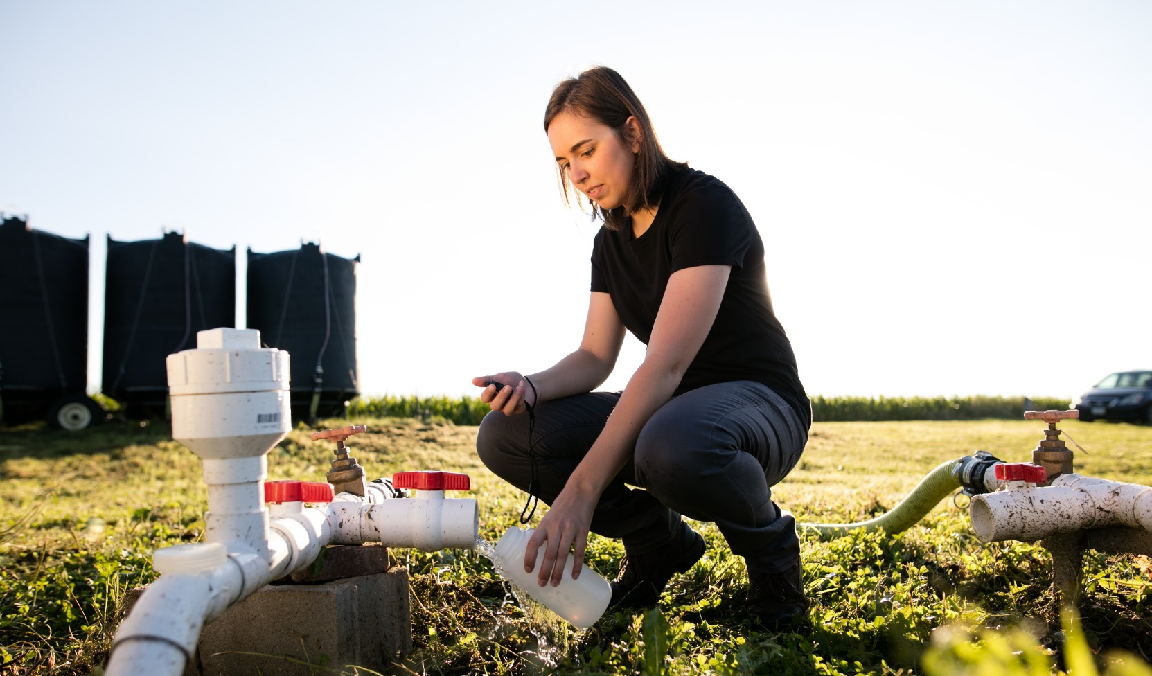
Biotechnology Outreach Education Center Office of Biotechnology
Woodchip Bioreactors
Classroom Slides
Photo credit: Iowa State University
Updated 6/2022

Slide 2
Teachers,
Thank you for your interest in these resources from the Biotechnology Outreach Education Center. We value your partnership and appreciate your efforts to bring students unique and innovative experiences.
We are always seeking to improve our offerings, so please provide feedback using the QR codes below.
Eric Hall
BOEC Program Coordinator
TEACHER NOTES

Slide 3
Important Notes:
This presentation is designed to accompany the “From Here to There with Woodchip Bioreactors” curriculum modules. You can check out our website for additional resources.
Please add, modify, and improve the slides in this presentation. They are simply meant as a starting point and you are encouraged to make any changes that will improve your students’ experiences.
If you have questions or need further assistance, please check out the About Us page on the BOEC website.
TEACHER NOTES

Slide 4
The activities and labs within these curriculum modules are designed to use low-cost and locally-available supplies. Teachers should, however, feel comfortable substituting materials and supplies where necessary, when specified items are not available.
Some materials will need to be obtained from other sources such as local home centers or online retailers.
As with any hands-on science experiences, teachers and students should observe all appropriate safety guidelines, whether explicitly mentioned in this booklet, or not.
TEACHER NOTES

Slide 5
Written with a Focus on the Science & Engineering Practices
Even if you’re not teaching in a school required to help students develop the NGSS Science & Engineering Practices (SEPs), they will serve as good reminders for how research scientists work.
Each activity’s slide shows the targeted SEPs color-coded and linked for additional information. This linked content can be used by the teacher, students, or both to learn more about the Practices and how they can serve to help students make sense of the anchor phenomenon.
Additionally, the student notebook that accompanies this curriculum incorporates language from the SEPs and opportunities for purposeful student reflection around their use.
TEACHER NOTES

Slide 6
Click the icons below to navigate, or simply move forward in the presentation to view all slides.
INTRO MODULE 1 MODULE 2 MODULE 3
A Focus on Research
Activity 1: Getting to Know the Gulf Dead Zone
Activity 4: What’s in My Water?
Activity 8: Chesapeake Bay Case Study
Exploring the Gulf Dead Zone
Activity 5: Bioreactor Materials Research
Activity 9: A Part of the Solution
Activity 2: Hello, My Name is Nitrogen
Activity 6: Bioreactor Experiment & the Lab-O-Matic
Activity 3: Sorting Out the Nitrogen Cycle
Activity 7: DNA Analysis of Microbe Ecosystems

Slide 7
A Focus on Research
The goal of Dr. Soupir’s research program is to conduct basic research to move us toward more sustainable water systems.
Dr. Soupir uses lab- and field-based research projects to monitor the occurrence, fate and movement of nutrients and microorganisms in surface and drainage water.
The Soupir lab experiments with woodchip bioreactors, which are essentially buried trenches filled with woodchips or other materials.
Denitrifying bacteria on these materials help to remove nitrates from field runoff before moving into waterways.
Dr. Soupir’s students manipulate a variety of variables including hydraulic retention times, bioreactor fill materials, and influent nutrient conditions to determine the effectiveness and efficiency of the bioreactors and investigate ways to make bioreactors work better.
Photo credit: Iowa State University
Dr. Michelle Soupir

Slide 8
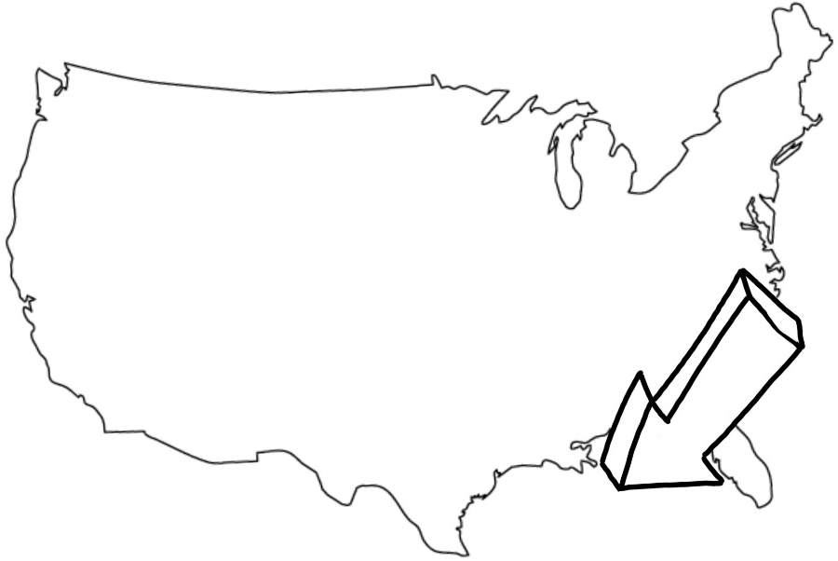
Exploring the Gulf Dead Zone Our Anchor Phenomenon
This large dead zone is caused primarily by nutrient pollution that comes from agriculture and urban land runoff which ends up in the Mississippi River.
This hypoxic zone has been present for decades, but each year the size and other characteristics of the area change.

Slide 9
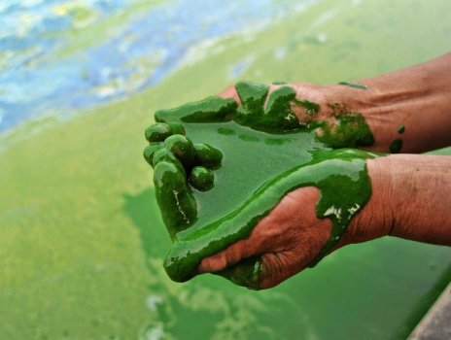
Getting to Know the Gulf Dead Zone Module 1, Activity #1
Students will…
…obtain and evaluate information from a variety of sources.
…write, categorize and prioritize questions generated by themselves and other class members.
…ensure questions developed relate directly to the phenomenon.
Photo credit: Algae's the cause! (source unknown)

Slide 10
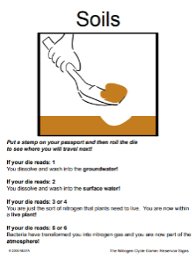
Hello, My Name is: Nitrogen Module 1, Activity #2
Students will…
…explain where nitrogen is found on Earth and that nitrogen cycles indefinitely through the Earth system.
…learn that the cycle is nonlinear traveling between living things and the physical environment.
Credit: this activity was developed by Lisa Gardiner of the UCAR Center for Science Education; permission was granted for use in this curriculum module

Slide 11
Sorting Out the Nitrogen Cycle Module 1, Activity #3
Students will…
…create a visual model of the nitrogen cycle.
…begin to develop an understanding of how nitrogen is transformed through natural processes.
Graphic credit: PresenterMedia.com

Slide 12
Module 1 Debrief
What did we learn?
You generated questions that got you thinking more about the Gulf Dead Zone (GDZ). How will you use these questions to help guide the next steps in learning about the phenomenon?
The nitrogen cycle provided you with a concrete experience that reinforced the learning from the models that you generated. You should start to understand that the movement of nitrogen through a system can be impacted by humans and other factors. When the number of organisms is changed, or a farmer spreads fertilizer on a field, the movement of nitrogen is altered in predictable ways. You should start to form ideas of how these impacts could eventually lead to possible solutions as you learn more about the GDZ problems.
You should better understand the complexity of the nitrogen cycle. It’s important that you begin to connect the various ‘parts’ of the cycle with events associated with the GDZ phenomenon. The nitrogen cycle can take place in a small field while also playing out on a regional or even global scale.

Slide 13
Module 1 Debrief, cont.
Putting the Pieces Together
At this point in the unit, you may see the Gulf Dead Zone and nitrogen cycle as unrelated concepts. You might be starting to develop understanding of how human activities can impact the movement of nitrogen, which impacts our anchor phenomenon.
Essentially, module 1 is all about setting the stage by putting the pieces of the puzzle on the table. Soon, you will begin to experience the science that will help you develop possible solutions to the GDZ problems and put the pieces together in a way that creates a clear picture of the issues.

Slide 14
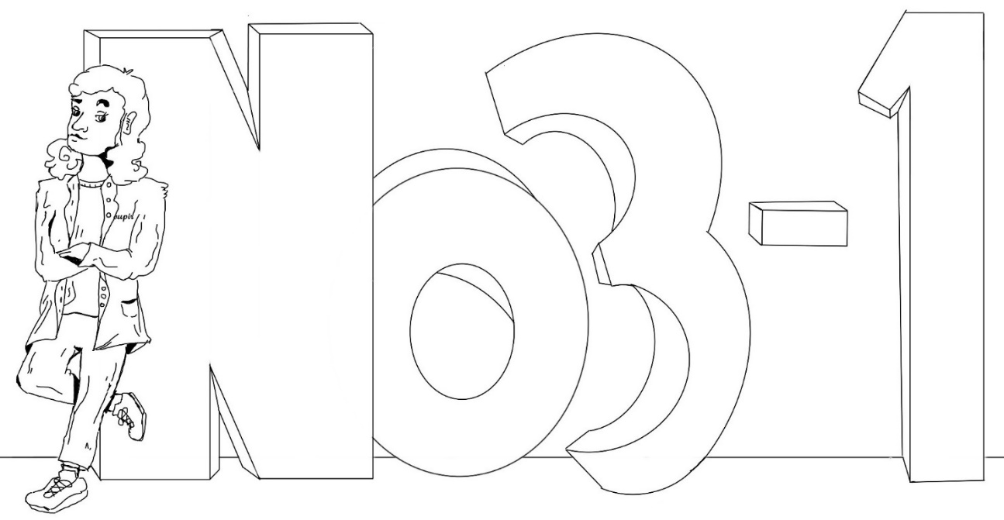
What’s in My Water? Module 2, Activity #4
Students will…
…explore parameters concerning water quality from different sources.
…practice analytical skills when accurately collecting data.
…analyze and interpret data obtained to determine overall quality of water samples.
Graphic credit: Pyo Aung

Slide 15
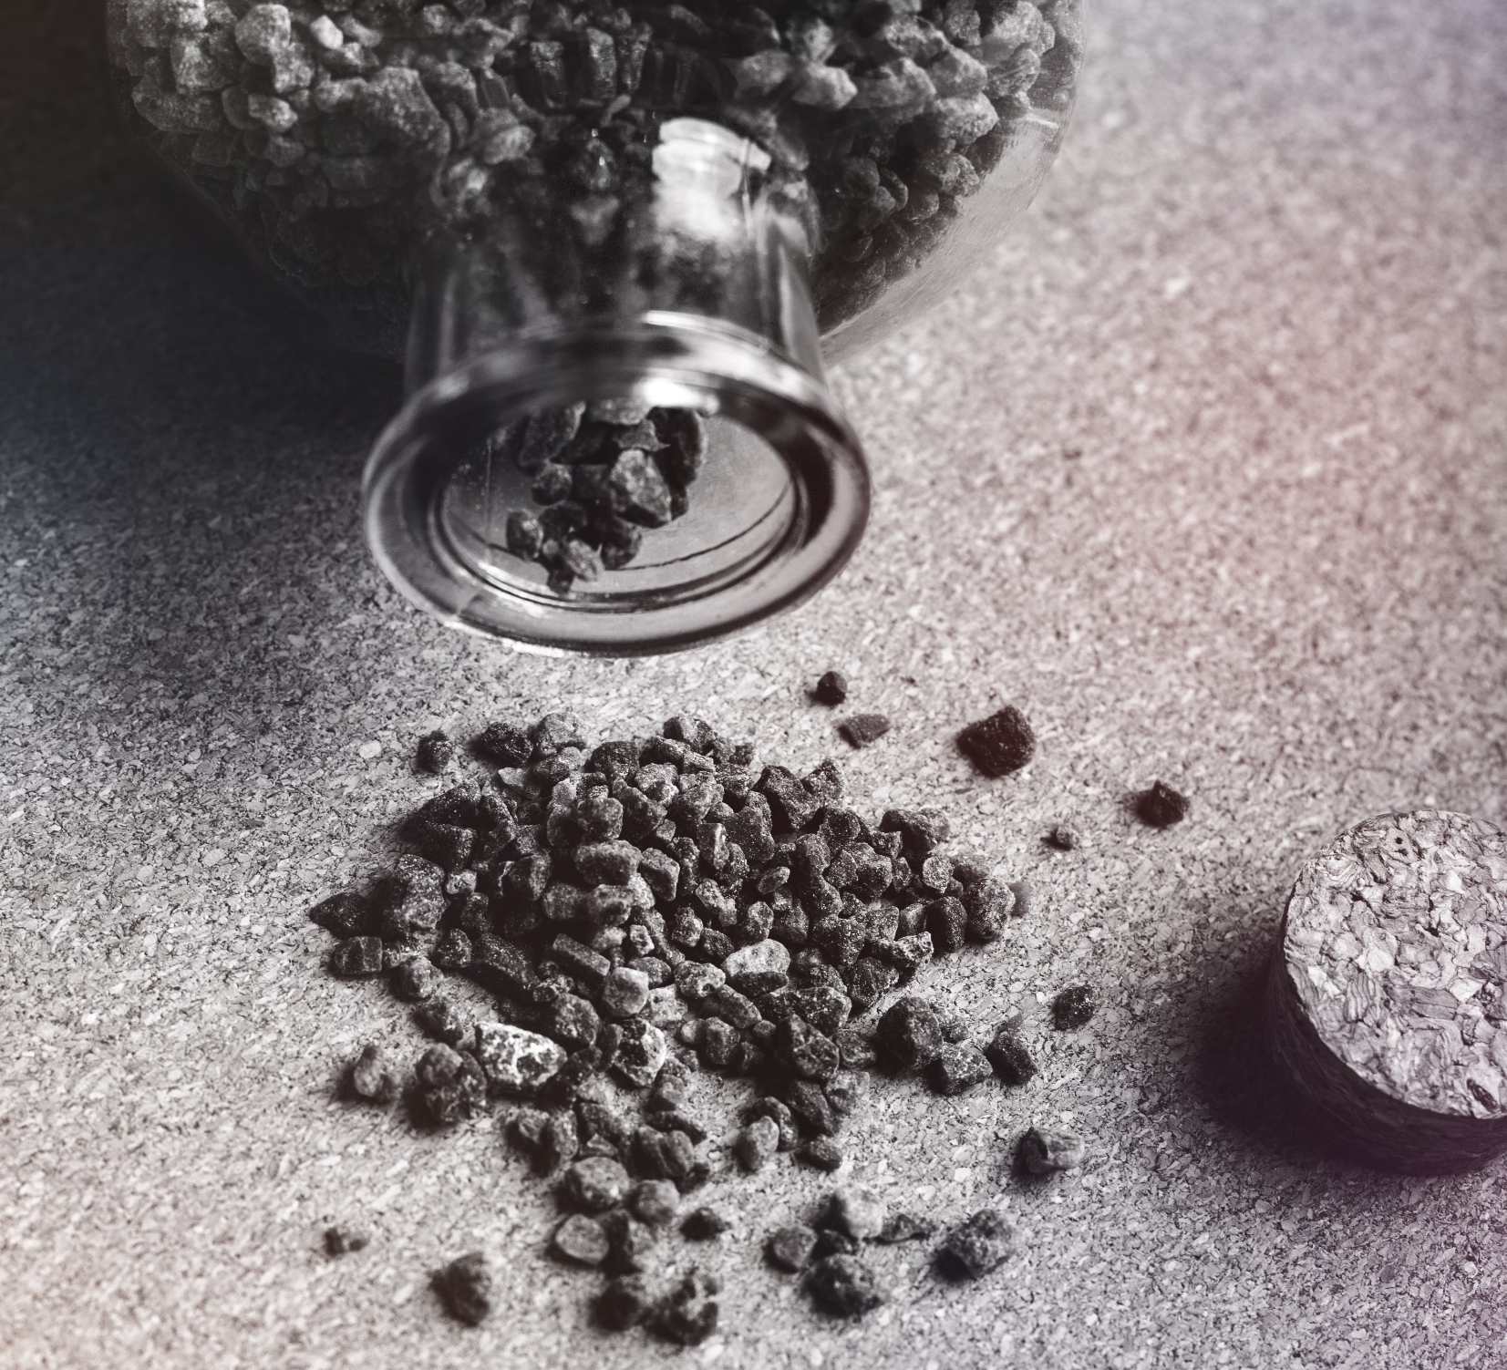
Bioreactor Materials Research Module 2, Activity #5
Students will…
…obtain, evaluate and communicate information about the basic properties of various materials and potential usefulness as a substrate in a denitrifying bioreactor.
…begin to develop an understanding of what criteria are necessary for materials to serve as substrates in denitrifying bioreactors.
Photo credit: Pexels.com

Slide 16
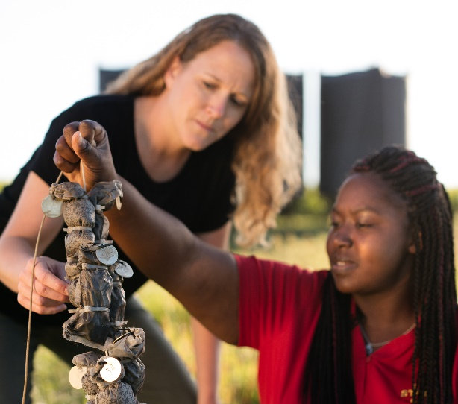
Denitrifying Bioreactor Experiment Module 2, Activity #6
Students will…
…plan an investigation which is valid and addresses issues raised as part of the anchor phenomenon.
…analyze and interpret data collected during the investigation.
…communicate findings to classmates in appropriate ways.
Photo credit: Iowa State University

Slide 17
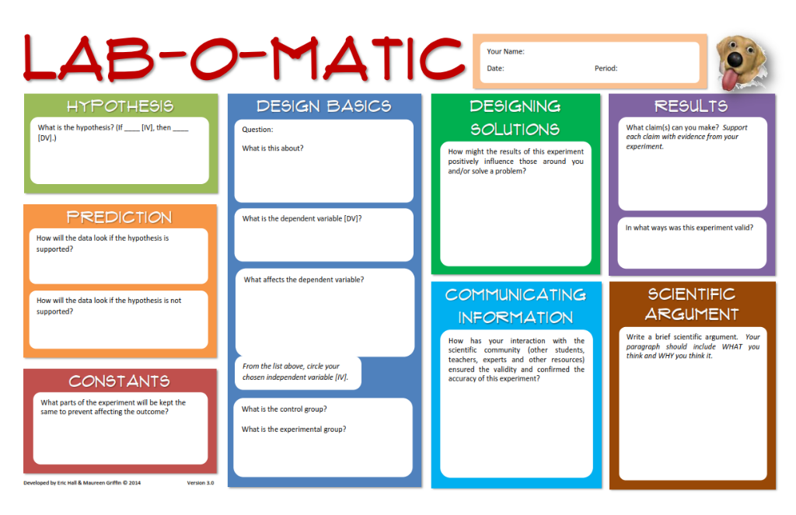
Denitrifying Bioreactor Experiment Module 2, Activity #6a
Consider what you already know about bioreactor fill materials, the nitrogen cycle, and experimental design.
Create an experiment which provides evidence you can use to create an argument for the use of a particular fill material.
You may begin anywhere on the Lab-O-Matic, but make sure the first two columns are complete before starting your experiment.
Photo credit: Iowa State University

Slide 18
Denitrifying Bioreactor Experiment Module 2, Activity #6b
Follow your teacher’s instructions to set up your classroom-scale bioreactor.
It’s important to note that you may not set up a bioreactor that’s directly related to your experiment. This is why your entire class is setting up bioreactors.
You will analyze the class’s data to determine if your hypothesis was supported or not.
Photo credit: Iowa State University

Slide 19
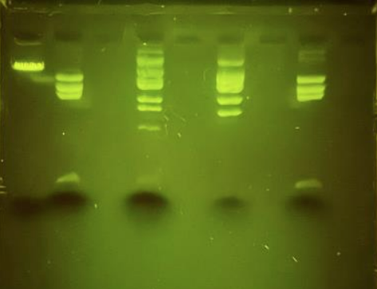
Denitrifying Bioreactor Experiment Module 2, Activity #7
Students will…
...use appropriate biotechnology tools to analyze and evaluate DNA fingerprinting data.
...evaluate the impact of new DNA fingerprinting data on the working explanation of what’s causing the Gulf dead zone.
...ask additional questions to clarify and continue refining their model and explanation.

Slide 20
Module 2 Debrief
What did we learn?
You became more familiar with the analysis of water and some of its properties/qualities that we can study. The Gulf Dead Zone phenomenon is all about water quality, so it only makes sense that you need to know what aspects of water are most closely related to the GDZ issues.
Activity #5 was all about learning how denitrifying bioreactors work…or, are supposed to work. Although much of the current research is being done using woodchips, scientists are looking into other options, and trying to decide if woodchips are the most effective material to use. This activity is all about you learning about the requirements necessary for denitrification to take place in a bioreactor, and which substances will best support those conditions.
Through experimentation, you should have learned that some fill materials are capable of helping to create the conditions necessary for denitrification to take place (i.e., semi-rough surface, usable carbon source for ‘food’, and a lack of antibiotic properties). Results from your experiments are sure to be mixed, and there are some inherent difficulties with the investigation, but it should have sparked some discussion around bioreactor set-up and effectiveness.

Slide 21
Module 2 Debrief, cont.
What did we learn?
This DNA fingerprinting investigation was designed to help students incorporate one more piece of information into their mental model relating to the GDZ problem. Students should have discovered that one type of bacteria waspresent in greater quantities than others in the “super-efficient” bioreactor it was collected from.

Slide 22
Module 2 Debrief, cont.
Putting the Pieces Together
You should be able to see how nitrogen (nitrates), woodchip bioreactors, and the Gulf Dead Zone are related. You should be asking questions like “if nitrates are part of the problem in the Gulf, how can we help reduce the amount of them that comes from our area?” or “how many of these bioreactors would we need to really impact the Gulf Dead Zone problem?”.
It’s crucial that you always think back to the anchor phenomenon and reflect on your initial “sticky note questions” so you understand how your work, so far, has helped to answer some of your questions.

Slide 23
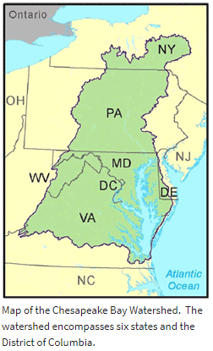
Chesapeake Bay Case Study Module 3, Activity #8
Students will…
…engage in argument from evidence provided in a variety of sources.
…obtain, evaluate and communicate information in a way that persuades others to appreciate the position presented.
…generalize information in a way so that it can be used in other settings.
Photo credit: Iowa State University

Slide 24
Chesapeake Bay Case Study Module 3, Activity #8
Quietly read the Chesapeake Bay TMDL Fact Sheet. Discuss any questions briefly as a class.
Divide into five groups. Each group will represent one of the stakeholders:
agricultural interests (i.e., Farm Bureau)
Environmental Protection Agency (EPA)
Municipalities/point source dischargers
the fishing industry
the TMDL model development team
Research your stakeholder’s positions on the Chesapeake Bay TMDL development and enforcement. Work together in these “expert groups” to develop a 3-5 minute presentation which outlines whether or not the TMDL development and implementation should change, or why the current approach is best. It is important that you include background research to support your position.
Each group should present their position to the rest of the class. Students with other positions should be allowed to question and rebut the presented argument.
As a class, attempt to come to consensus regarding how the Chesapeake Bay TMDL should move forward, including any recommended changes in the process.
Photo credit: Iowa State University

Slide 25
A Part of the Solution Module 3, Activity #9 A Document-based Case Study
Students will…
…use construct a written argument based on data and evidence.
…write a cohesive, substantive response to the provided prompt.
…demonstrate knowledge of woodchip bioreactors, the nitrogen cycle and the Gulf Dead Zone and how the 3 are interrelated.
Photo credit: Iowa State University

Slide 26
A Part of the Solution Module 3, Activity #9 A Document-based Case Study
INSTRUCTIONS
You are about to begin an activity that is designed to measure your skills in critical thinking, reasoning, problem solving and written communication. In addition to these “think-like-a-scientist” skills, your knowledge about the nitrogen cycle, woodchip bioreactors and the Gulf Dead Zone will also be evaluated.
You will be preparing a written response to a hypothetical, but realistic situation. This activity contains a series of documents that includes a range of information sources. While your personal values and experiences are important, you should base your response on the evidence provided in these documents and the learning you’ve done as part of this unit.
Photo credit: Iowa State University

Slide 27
A Part of the Solution Module 3, Activity #9 A Document-based Case Study
THE SCENARIO
A friend of your family, Patty Stover, has come to you asking for help. She’s a farmer just outside of your city and knows that you have been studying about nitrates and water quality in school. Your parents have invited Patty over for dinner, but a soon as she enters your home, she starts asking you questions about what she should do!
Patty’s been fined by the local government because of the amount of nitrates she’s putting into a small stream that runs through her farmland. The stream eventually empties into a larger river, which flows into the Mississippi River. Patty farms mostly corn and soybeans and is generally very conscientious when it comes to using sustainable practices.
By the end of dinner, Patty has asked you to advise her on a new technology she’s heard about. Woodchip bioreactors, she says, are being researched at Iowa State University and might just be the answer she’s looking for to reduce the amount of nitrates going into nearby water ways. But she also knows there are some problems that go along with them, as well.
Photo credit: Iowa State University

Slide 28
A Part of the Solution Module 3, Activity #9 A Document-based Case Study
THE QUESTION
After analyzing the following documents, and using the knowledge you’ve gained during this unit, you must answer the following question: should Patty implement the use of woodchip bioreactors on her farmland?
Once you decide on an answer, you need to write a brief email to Patty. Let her know what your answer is and include specific evidence that supports your decision. Your argument may include information from the activities you’ve done as part of your class work, too.
Photo credit: Iowa State University

Slide 29
References
Applying Woodchip Bioreactors for Improved Water Quality. Applying Woodchip Bioreactors for Improved Water Quality, Iowa State University Extension and Outreach, 2017, store.extension.iastate.edu/product/14530.
Belva, Keeley. “Gulf of Mexico 'Dead Zone' Is the Largest Ever Measured.” Gulf of Mexico 'Dead Zone' Is the Largest Ever Measured | National Oceanic and Atmospheric Administration, www.noaa.gov/media-release/gulf-of-mexico-dead-zone-is-largest-ever-measured.
“Chesapeake Bay Total Maximum Daily Load (TMDL).” EPA, Environmental Protection Agency, 11 Jan. 2018, www.epa.gov/chesapeake-bay-tmdl.
Corwin, Emily. “Nitrate Risk Near Farms: A Hydrogeologist Explains.” Vermont Public Radio, digital.vpr.net/post/nitrate-risk-near-farms-hydrogeologist-explains#stream/0.
Goodwin, Marci. “Water Quality Experiment.” The Homeschool Scientist, 31 Aug. 2017, thehomeschoolscientist.com/water-quality-experiment/.
Hall, Eric, and Maureen Griffin. “Standard LOM.” Lab-o-Matic, www.labomatic.us/standard-lom.html.
Mandler, Daphna, et al. “Developing and Implementing Inquiry-Based, Water Quality Laboratory Experiments for High School Students To Explore Real Environmental Issues Using Analytical Chemistry.” Journal of Chemical Education, vol. 91, no. 4, Dec. 2014, pp. 492–496., doi:10.1021/ed200586r.
“Michelle Soupir.” Department of Agricultural and Biosystems Engineering, www.abe.iastate.edu/michelle-soupir/.
“National Primary Drinking Water Guidelines.” Environmental Protection Agency, May 2009.
“The Nitrogen Cycle Game.” UCAR Center for Science Education, scied.ucar.edu/activity/nitrogen-cycle-game.
Tyndall, JC, and Bowman. “IA NRS Cost Tool Overview.” Iowa State University, 2016.
Woodchip Bioreactors for Nitrate in Agricultural Drainage. Woodchip Bioreactors for Nitrate in Agricultural Drainage, Iowa State University Extension and Outreach, 2011, store.extension.iastate.edu/product/13691.

