Slide 1
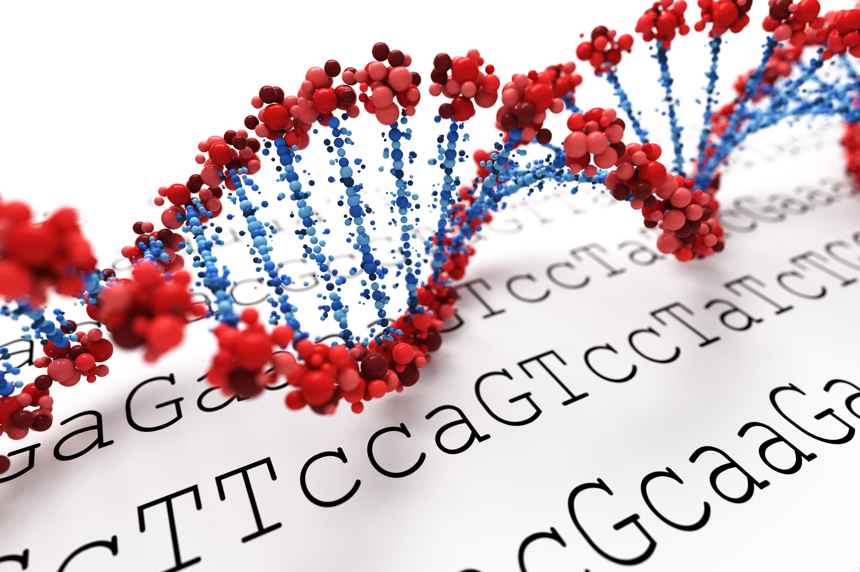
Biotechnology Outreach Education Center Office of Biotechnology
PCR Investigation
Classroom Slides

Slide 2
Teachers,
Thank you for your interest in these resources from the Biotechnology Outreach Education Center. We value your partnership and appreciate your efforts to bring students unique and innovative experiences.
We are always seeking to improve our offerings, so please provide feedback using the QR codes below.
Eric Hall
BOEC Program Coordinator
TEACHER NOTES

Slide 3
Important Notes:
This presentation is designed to accompany the “PCR Investigation” booklet. You can check out our website for additional resources.
The slides are designed with clickable buttons rather than a linear slideshow. On the overview pages, click one of the Step buttons to open up that slide. Once the slide is open, press the back button to return to the overview.
Please add, modify, and improve the slides in this presentation. They are simply meant as a starting point and you are encouraged to make any changes that will improve your students’ experiences.
If you have questions or need further assistance, please check out the About Us page on the BOEC website.
TEACHER NOTES

Slide 4
Classroom Impacts
PCR and gel electrophoresis are accessible ways for students to experience cutting-edge biotechnology.
This experiment allows students to visualize DNA replication and genetic variability, as well as how DNA structure lends itself to its function.
The analysis and interpretation of the final agarose gel incorporates multiple NGSS standards.
Experiencing these procedures will help prepare students for academic or industrial research, in addition to other career paths.
TEACHER NOTES

Slide 5
The activities and labs within these curriculum modules are designed to use low-cost and locally-available supplies. Teachers should, however, feel comfortable substituting materials and supplies where necessary, when specified items are not available.
Some materials will need to be obtained from other sources such as local home centers or online retailers.
As with any hands-on science experiences, teachers and students should observe all appropriate safety guidelines, whether explicitly mentioned in this booklet, or not.
TEACHER NOTES

Slide 6
Biotechnology Outreach Education Center Office of Biotechnology
PCR Investigation
Classroom Slides

Slide 7
PCR Investigation
Content Overview
Step 1
Cell collection
Cell prep
Step 2
DNA prep w/ PCR beads
Step 3
Program the mini16
PCR (thermocycling)
Step 4
Prep & load gel w/ ladder and DNA
Gel electrophoresis
Analyze gel
Add primers
Procedure Overview

Slide 8
Step 1: Cell Collection
The gene we are amplifying (or not) is the Alu gene.
The gene is a primate-specific, non-coding genomic insertion.
The gene and its variations have been inserted into the genome recently, with some in the last million years!
We are specifically searching for the TPA-25 (tissue plasminogen activator) insertion, which is dimorphic in the human genome. This leads to three outcomes, all with a different base-pair (bp) length:
TPA-25 Present Homozygous: 400-bp band
TPA-25 Absent Homozygous: 100-bp band
Heterozygous: both bands
To access the DNA, we must first collect human cells, then lyse the cell, and separate the DNA from the cell debris.
We use the X-tract buffer to lyse the cell, which means to disintegrate the cell wall.
Back to Overview

Slide 9
Step 2: DNA Prep
Once the cell is lysed, we need to separate the cell debris from the DNA. To do so, we spin the sample at high speed.
This results in two layers: the pellet (cell debris) and supernatant (dissolved DNA).
To successfully amplify the DNA, the following reagents are needed:
Template DNA: cheek cell DNA (from supernatant) to be amplified
Free deoxynucleotides: building blocks of new DNA strands (A, C, T, G)
Taq polymerase: enzyme which builds new DNA strands
Buffers: maintain the solution environment to protect DNA
Primers: short DNA sequences that serve as starting points for the polymerase
Back to Overview

Slide 10
Step 3: Polymerase Chain Reaction
Polymerase Chain Reaction (PCR) is the process of rapidly amplifying DNA. A successful PCR procedure can turn 2 copies of DNA into billions in just 2 hours!
PCR consists of three main steps:
Denaturation: The DNA double helix unravels, which allows primers to recognize their unique sequence on the template DNA.
Annealing: Primers bind to their complementary sequences.
Extension: DNA polymerase builds off of the primer to create a new DNA strand.
The process then repeats as many times as desired.
Each step is optimized at a specific temperature, which the thermocycler maintains.

Slide 11
Step 3: Polymerase Chain Reaction
PCR is a revolutionary technology that allows scientists to make billions of copies of DNA in a relatively short time.
This technique is used throughout biological research, as well as in medical and forensic settings.
PCR is also extensively used in biotechnology-oriented industries.
PCR and gel electrophoresis allow students to visualize DNA and its replication.
Back to Overview

Slide 12
Step 4: Gel Electrophoresis
To perform gel electrophoresis, we use agarose gels.
The agarose polysaccharides create a thick matrix within the gels, which makes it easier for smaller DNA molecules to travel than large ones.
By applying a negative charge at one end of the gel, the negatively charged DNA is repulsed and “runs” down the gel.
In addition to our samples, we will use a DNA ladder consisting of bands of a known DNA size. This allows us to estimate the length of our DNA bands.
Click to run

Slide 13
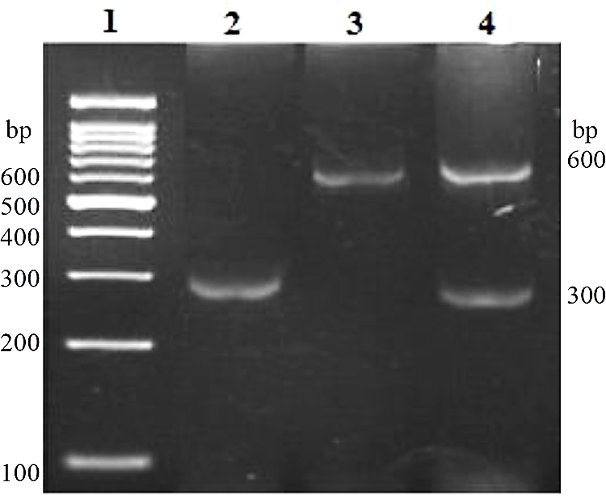
Step 4: Gel Electrophoresis
Ladder
Alu -/-
Alu +/+
Alu +/-
The gel to the left shows a set of example results from amplifying and running Alu gene products. Note that the band length is different than expected for our experiment.
Back to Overview
Yasin, Salem R. et al. “Alu DNA Polymorphism of Human Tissue Plasminogen Activator (tPA) Gene in Diabetic Jordanian Patients.” Iranian biomedical journal vol. 23,6 (2019): 423-8. doi:10.29252/ibj.23.6.423

Slide 14
PCR Investigation
Procedure Overview
Step 1
Cell collection
Cell prep
Step 2
DNA prep w/ PCR beads
Step 3
Program the mini16
PCR (thermocycling)
Step 4
Prep & load gel w/ ladder and DNA
Gel electrophoresis
Analyze gel
Add primers
Review Questions

Slide 15
Step 1: Cell Collection
With a sterile toothpick, gently scrape the inside of your cheek about 5 times.
Swirl the toothpick gently in the X-Tract™ buffer tube. Label tube.
Incubate at 95°C for 10 minutes using the mini16 miniPCR® thermal cycler. Refer to Part 3 on Page 7 to find out more about using the miniPCR® system.
Spin the tube at 5000rpm to create the pellet of cell debris. The pellet will be small and faint at the bottom of the tube.
Keep on ice/refrigerated until Step 2.
Back to Overview

Slide 16
PCR Investigation
Procedure Overview
Step 1
Cell collection
Cell prep
Step 2
DNA prep w/ PCR beads
Step 3
Program the mini16
PCR (thermocycling)
Step 4
Prep & load gel w/ ladder and DNA
Gel electrophoresis
Analyze gel
Add primers
Review Questions

Slide 17
Step 2: DNA Prep
Gather lysed cheek cell tube from Step 1, primers, sterile water, and a tube with a PCR bead.
The PCR bead contains Taq polymerase, free deoxynucleotides, and buffer.
Keep primers on ice when not in use.
Label PCR bead tube.
With a 20µL pipette, add the following reagents to the PCR tube:
Sterile water | 16.0µL
Upper primer (5pmol/µL) | 2.0µL
Lower primer (5pmol/µL) | 2.0µL
Cheek cell supernatant (Step 1) | 5.0µL
Total Volume | 25.0µL
Back to Overview

Slide 18
PCR Investigation
Procedure Overview
Step 1
Cell collection
Cell prep
Step 2
DNA prep w/ PCR beads
Step 3
Program the mini16
PCR (thermocycling)
Step 4
Prep & load gel w/ ladder and DNA
Gel electrophoresis
Analyze gel
Add primers
Review Questions

Slide 19
Step 3: Polymerase Chain Reaction
If not yet connected, connect to your mini16 miniPCR® thermal cycler using the miniPCR® app.
Select the “Flex” protocol from the selection menu.
Click “Add Step” and choose “PCR.” Configure Step 1 using the parameters described on Page 9.
The final “Heat Block” step is optional, depending on the time available in class.
Once you have created the code for your miniPCR® system, press the “Run” button. The light should blink green to indicate a successful run.
Use the “Monitor” tab to check on your run. The “Graph” tab will give an estimate of the amount of DNA copies in your sample.
Back to Overview

Slide 20
PCR Investigation
Procedure Overview
Step 1
Cell collection
Cell prep
Step 2
DNA prep w/ PCR beads
Step 3
Program the mini16
PCR (thermocycling)
Step 4
Prep & load gel w/ ladder and DNA
Gel electrophoresis
Analyze gel
Add primers
Review Questions

Slide 21
Step 4: Gel Electrophoresis (Casting)
Make a 2.0% gel using 20mL of distilled water and 1 blueGel gel tab.
Swirl solution until the gel tab is broken down.
Heat the solution for 15 seconds twice or until there is no more floating gel debris. The solution is transparent yellow when the tab is fully dissolved.
Once the solution is cool to the touch, you can pour it slowly into the molding tray. We will use the wide combs from the bottom of the molding tray.
After about 20 minutes, remove the combs. If you are storing the gels, keep it in a resealable bag with a wet paper towel.

Slide 22
Step 4: Gel Electrophoresis (Running)
Place the gel tray and gel in the buffer chamber. Add 30mL of TBE buffer– cover the gel but don’t overflow!
Add 4µl of loading dye to each PCR sample. Also add 4µl of loading dye to the 100bp DNA ladder tube.
Using the 20µl pipette, slowly load the samples into the wells, being careful not to puncture the gel.
Press the power button to start the run. Allow the gel to run 35-50 minutes. Use the lightbulb button to view your gel as it runs.
Use the DNA ladder image on Page 16 to determine your TPA-25 insertion status.
Back to Overview

Slide 23
PCR Investigation
Procedure Overview
Step 1
Cell collection
Cell prep
Step 2
DNA prep w/ PCR beads
Step 3
Program the mini16
PCR (thermocycling)
Step 4
Prep & load gel w/ ladder and DNA
Gel electrophoresis
Analyze gel
Add primers
Review Questions

Slide 24
Review Questions
Why is it important to change pipette tips after each use?
What are some things that could cause a PCR to fail?
Why are there upper (forward) and lower (reverse) primers?
Some PCR labs include the use of a negative control. This is a mixture of all PCR reaction components except for the targeted DNA template. Why would this be a useful addition to our investigation?
How is this investigation similar to or different from the PCR diagnostic test for COVID-19? You may need to do some research!

Slide 25
Thank you!!!

