Slide 1
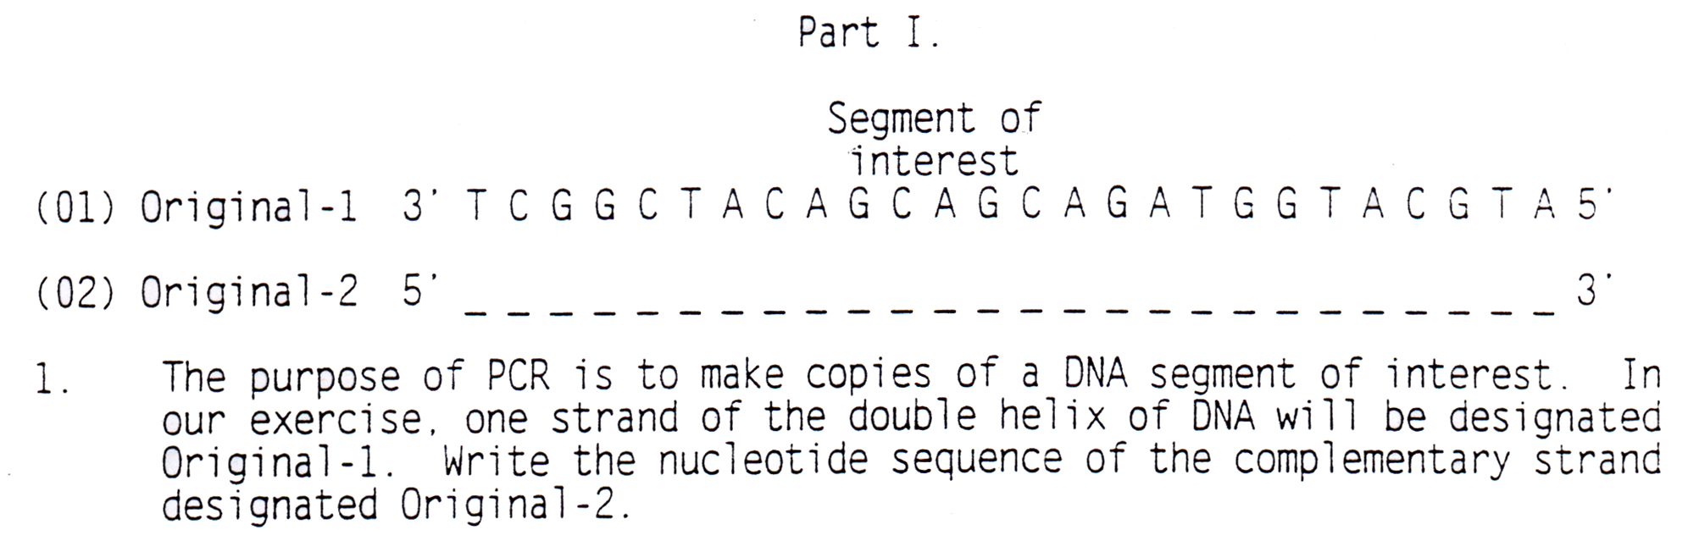
Polymerase Chain Reaction (PCR)
Part I
Segment of Interest
A G C C G A T G T C G T C G T C T A C C A T G C A T

Slide 2
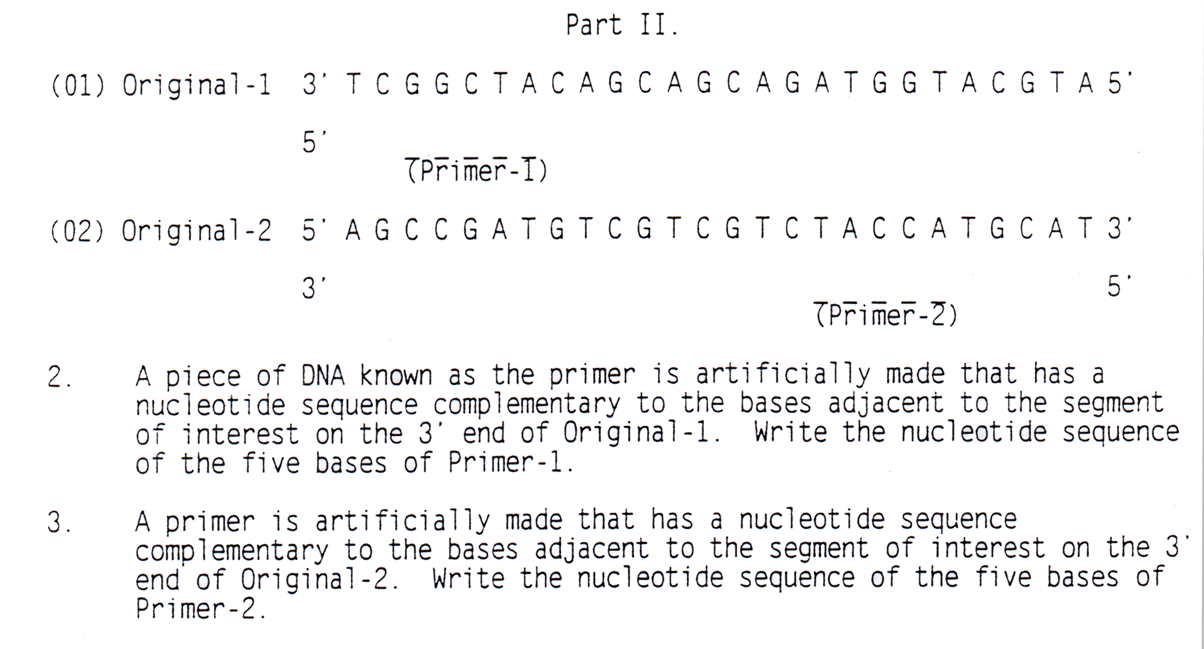
Part II
C C G A T
A T G G T

Slide 3
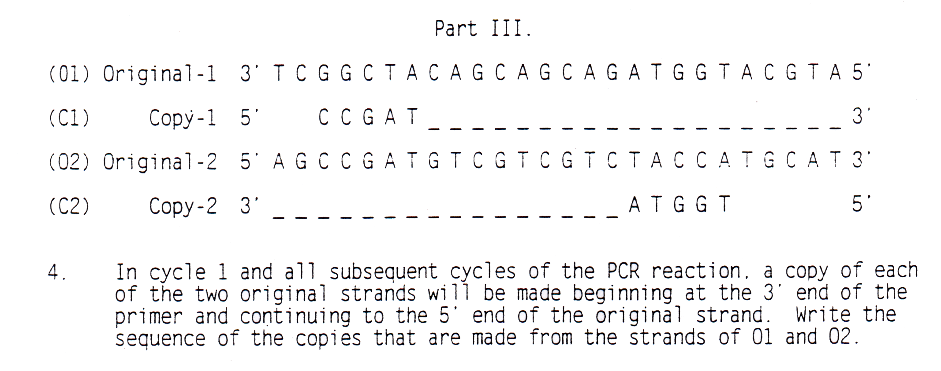
Part III
C C G A T G T C G T
A G C A G A T G G T

Slide 4
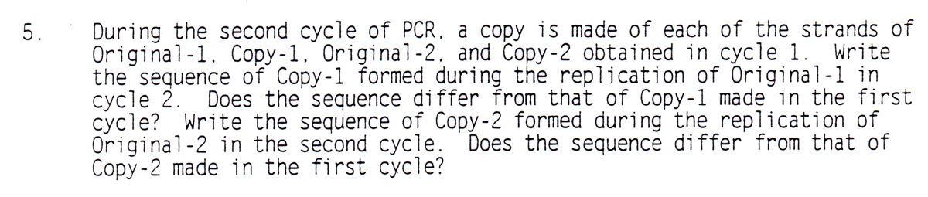
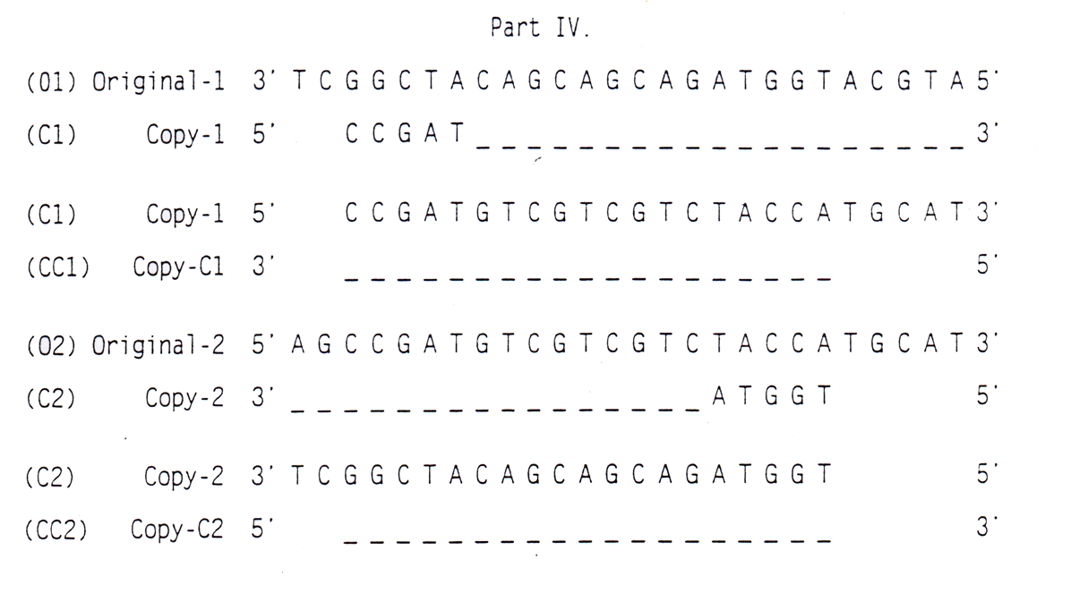
Part IV
C C G A T G T C G T
A G C A G A T G G T

Slide 5
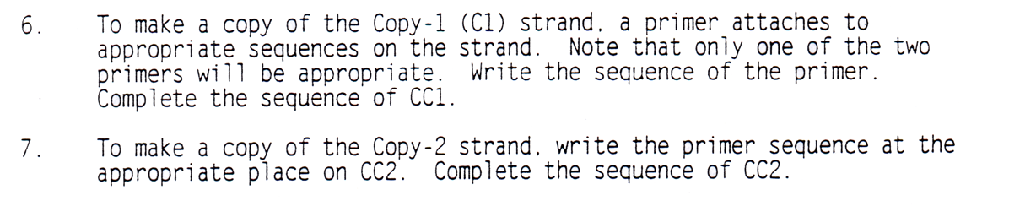
Part IV
C C G A T G T C G T
G G C T A C A G C A G C A G A T G G T
A G C A G A T G G T
C C G A T G T C G T C G T C T A C C A

Slide 6
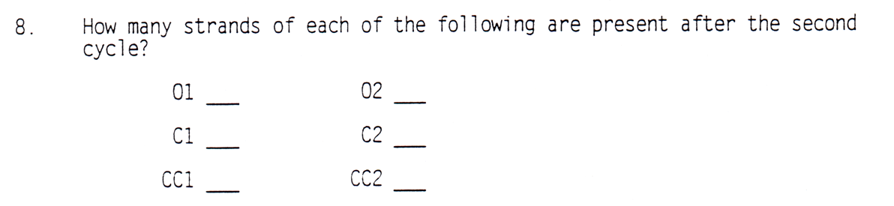
Part IV
C C G A T G T C G T
G G C T A C A G C A G C A G A T G G T
A G C A G A T G G T
C C G A T G T C G T C G T C T A C C A
1
1
2
2
1
1

Slide 7
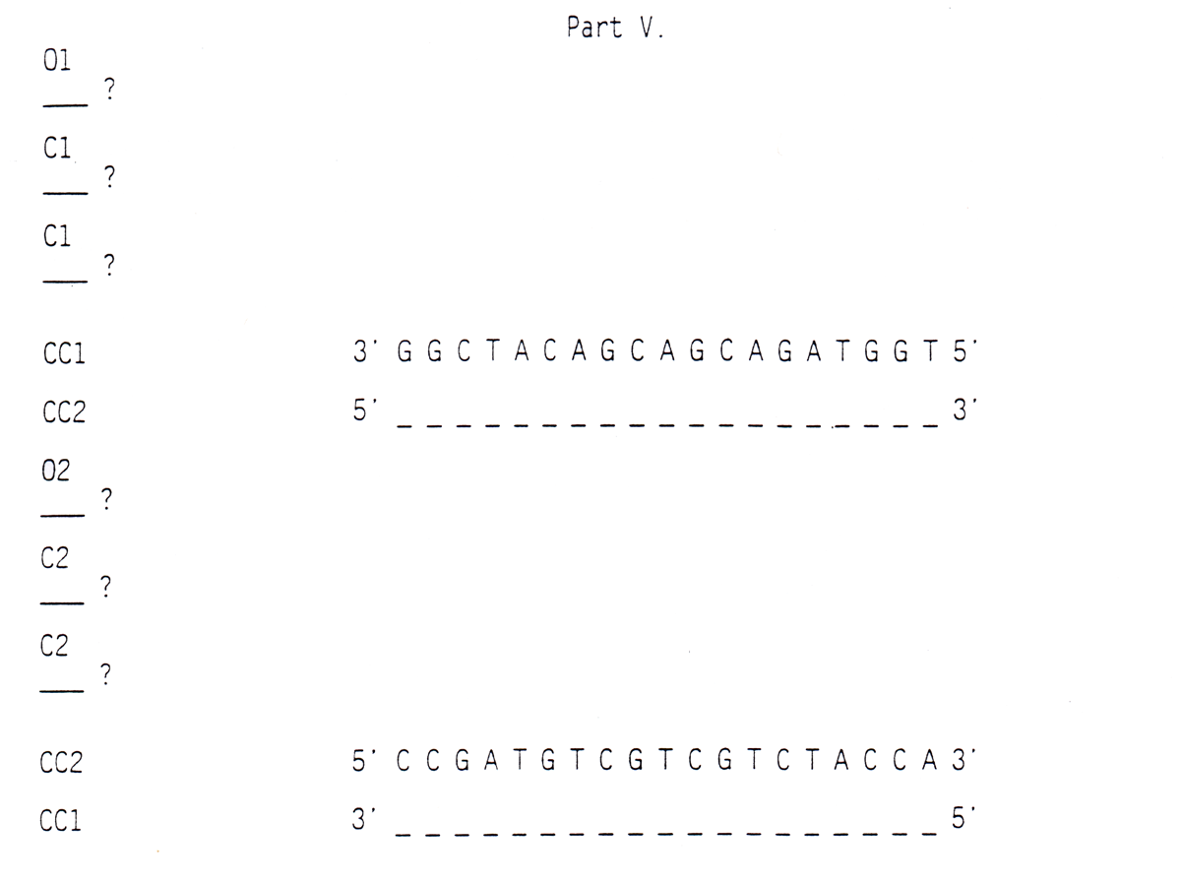
Part V
3’ T C G G C T A C A G C A G C A G A T G G T A C G T A 5’
C1
5 ‘ C C G AT G T C G T C G T C T AC C A T G C A T 3’
C C G A T G T C G T C G T C T A C C A T G C A T
CC1
C C G A T G T C G T C G T C T A C C A T G C A T
CC1
5’ A G C C G A T G T C G T C G T C T A C C A T G C A T 3’
C2
T C G G C T A C A G C A G C AG A T G G T
T C G G C T A C A G C A G C AG A T G G T
CC2
T C G G C T A C A G C A G C AG A T G G T
CC2

Slide 8
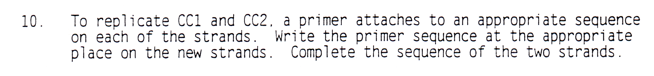
Part V
3’ T C G G C T A C A G C A G C A G A T G G T A C G T A 5’
C1
5 ‘ C C G AT G T C G T C G T C T AC C A T G C A T 3’
C C G A T G T C G T C G T C T A C C A T G C A T
CC1
G G C T A C A G C A G C A G A T G G T
C C G A T G T C G T C G T C T A C C A T G C A T
CC1
G G C T A C A G C A G C A G A T G G T
5 ‘ C C G A T G T C G T C G T C T A C C A 3’
5’ A G C C G A T G T C G T C G T C T A C C A T G C A T 3’
C2
T C G G C T A C A G C A G C AG A T G G T
T C G G C T A C A G C A G C AG A T G G T
CC2
C C G A T G T C G T C G T C T A C C A
T C G G C T A C A G C A G C AG A T G G T
CC2
C C G A T G T C G T C G T C T A C C A
G G C T A C A G C A G C A G A T G G T

Slide 9
Part V
3’ T C G G C T A C A G C A G C A G A T G G T A C G T A 5’
C1
5 ‘ C C G AT G T C G T C G T C T AC C A T G C A T 3’
C C G A T G T C G T C G T C T A C C A T G C A T
CC1
G G C T A C A G C A G C A G A T G G T
C C G A T G T C G T C G T C T A C C A T G C A T
CC1
G G C T A C A G C A G C A G A T G G T
5 ‘ C C G A T G T C G T C G T C T A C C A 3’
5’ A G C C G A T G T C G T C G T C T A C C A T G C A T 3’
C2
T C G G C T A C A G C A G C AG A T G G T
T C G G C T A C A G C A G C AG A T G G T
CC2
C C G A T G T C G T C G T C T A C C A
T C G G C T A C A G C A G C AG A T G G T
CC2
C C G A T G T C G T C G T C T A C C A
G G C T A C A G C A G C A G A T G G T

Slide 10
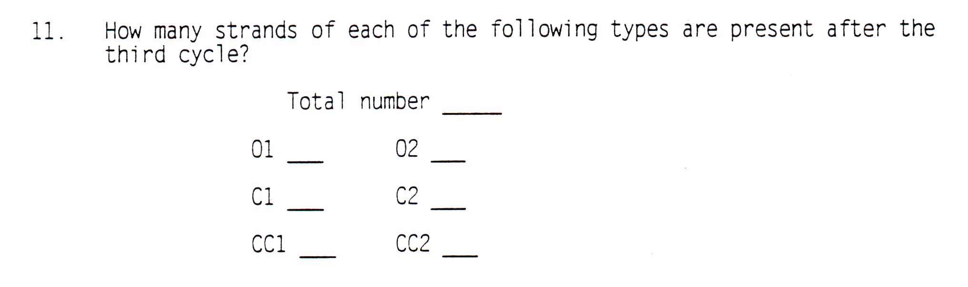
Part V
16
1
1
3
3
4
4

Slide 11
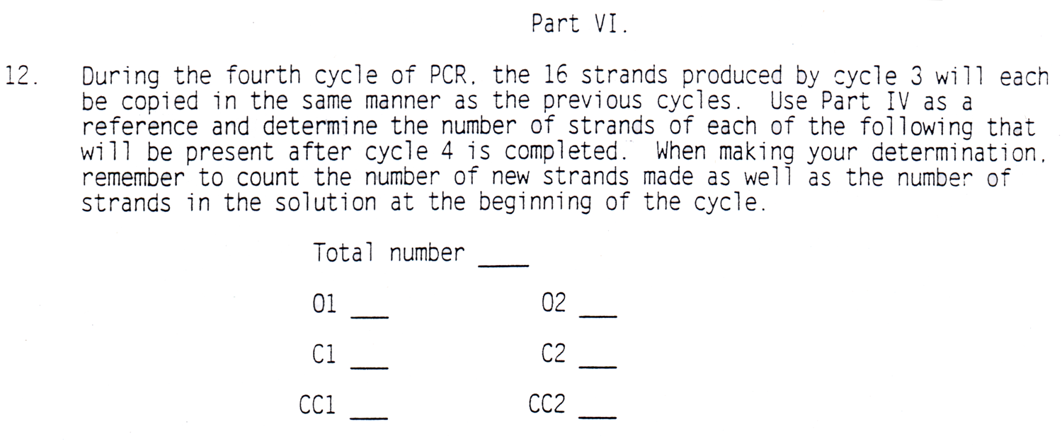
Part VI
32
1
1
4
4
11
11

Slide 12
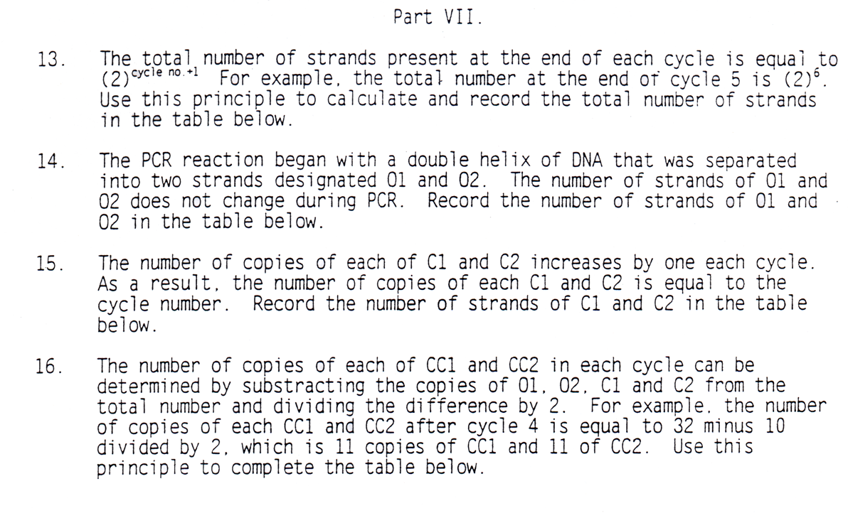
Part VII

Slide 13
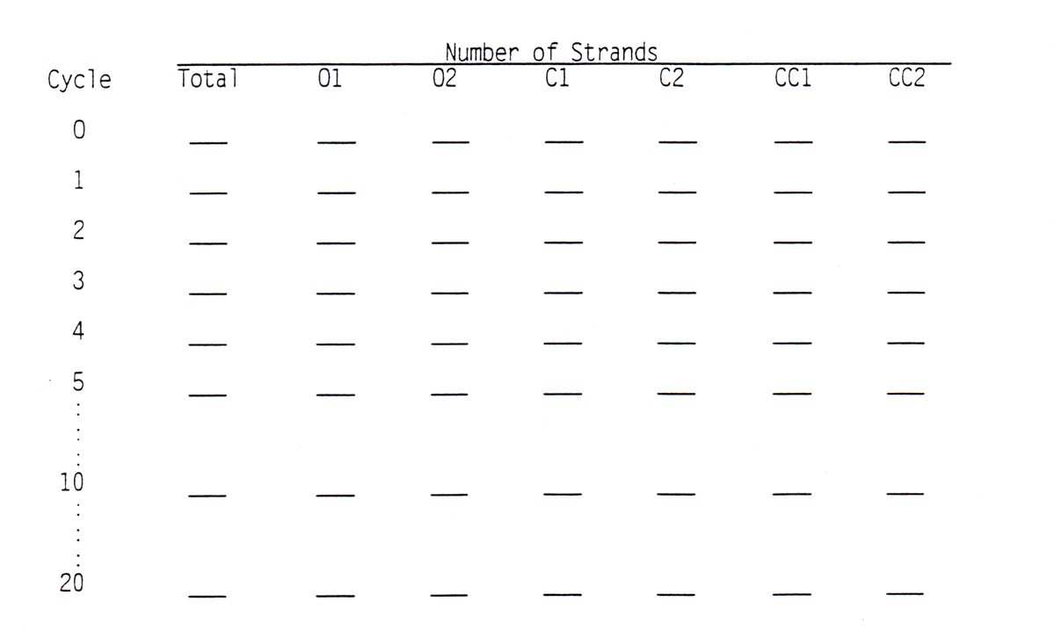
Part VII
2
1
1
0
0
0
0
4
1
1
1
1
0
0
8
1
1
2
2
1
1
16
1
1
3
3
4
4
32
1
1
4
4
11
11
64
1
1
5
5
26
26
2048
1
1
10
10
1013
1013
1,048,555
2,097,152
1
1
20
20

