Slide 1
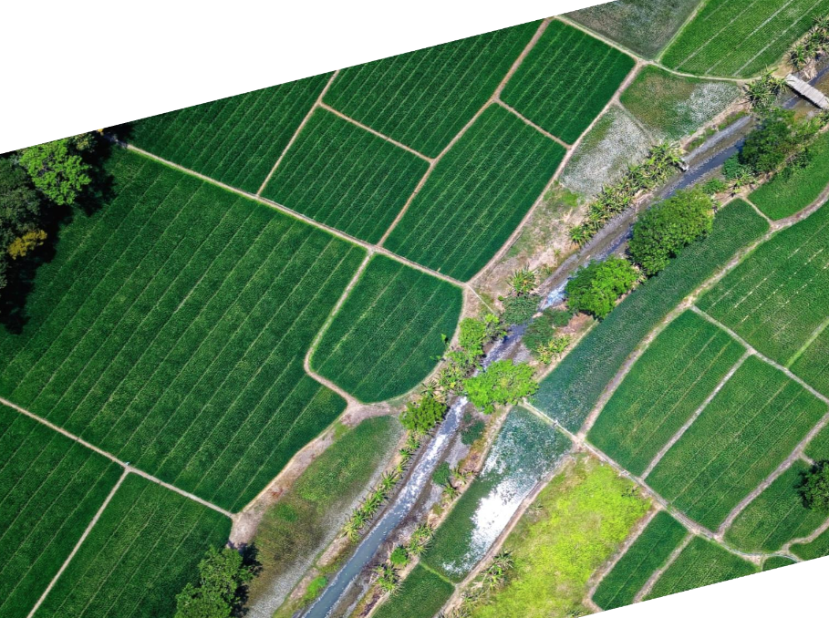
Biotechnology Outreach Education Center Office of Biotechnology
Antimicrobial Resistance in Agriculture
Classroom Slides
Photo credit: pexels.com
Updated 9/2022

Slide 2
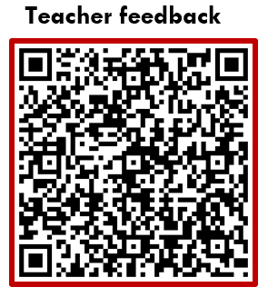
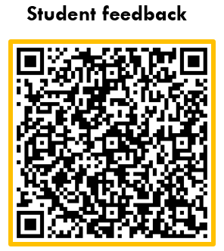
Teachers,
Thank you for your interest in these resources from the Biotechnology Outreach Education Center. We value your partnership and appreciate your efforts to bring students unique and innovative experiences.
We are always seeking to improve our offerings, so please provide feedback using the QR codes below.
Eric Hall
BOEC Program Coordinator
TEACHER NOTES

Slide 3
Important Notes:
This presentation is designed to accompany the “What Can We Do?” curriculum modules. You can check out our website for additional resources.
Please add, modify, and improve the slides in this presentation. They are simply meant as a starting point and you are encouraged to make any changes that will improve your students’ experiences.
If you have questions or need further assistance, please visit the Contact Us page on the BOEC website.
TEACHER NOTES

Slide 4
The activities and labs within these curriculum modules are designed to use low-cost and locally-available supplies. Teachers should, however, feel comfortable substituting materials and supplies where necessary, when specified items are not available.
Some materials will need to be obtained from other sources such as local home centers or online retailers.
As with any hands-on science experiences, teachers and students should observe all appropriate safety guidelines, whether explicitly mentioned in this booklet, or not.
TEACHER NOTES

Slide 5
Written with a Focus on the Science & Engineering Practices
Even if you’re not teaching in a school required to help students develop the NGSS Science & Engineering Practices (SEPs), they will serve as good reminders for how research scientists work.
Each activity’s slide shows the targeted SEPs color-coded and linked for additional information. This linked content can be used by the teacher, students, or both to learn more about the Practices and how they can serve to help students make sense of the anchor phenomenon.
Additionally, the student notebook that accompanies this curriculum incorporates language from the SEPs and opportunities for purposeful student reflection around their use.
TEACHER NOTES

Slide 6
Click the icons below to navigate, or simply move forward in the presentation to view all slides.
INTRO MODULE 1 MODULE 2 MODULE 3 MODULE 4
A Focus on Research
Activity 1: Getting to Know the Puppy Problem
Activity 2: What are microbes?
Activity 5: Determining resistance in bacterial populations
Activity 8: Jyll & Jakk dilemma (assessment)
Activity 3: How does AMR happen?
Activity 6: Transforming bacterial DNA: ampicillin resistance
Activity 4: What role does DNA play in the life of a bacterium?
Activity 7: One Health in action
Module 2 debrief
Module 3 debrief

Slide 7
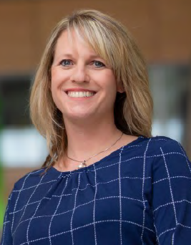
A Focus on Research
The goal of Dr. Howe’s and Dr. Soupir’s research program is to study the development of antimicrobial resistance and how it moves through ecosystems.
They uses lab- and field-based research projects to monitor the occurrence and movement of antimicrobial resistance.
Antimicrobials are used widely in animal production. They improve animal health and animal welfare, and also enhance animal growth rates and raise animal productivity.
The use of antimicrobials, however, can lead to the emergence of resistance and the transmission of resistant genes and resistant bacteria between species
The condition of antimicrobial resistance (AMR) develops when potentially harmful organisms such as bacteria, viruses and fungi no longer respond to medications generally used against them.
Dr. Michelle Soupir Dr. Adina Howe

Slide 8
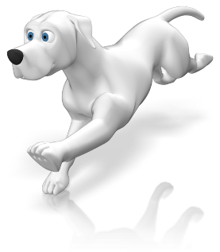
Getting to Know the Puppy Problem Module 1, Activity #1
Students will…
…obtain and evaluate information from a variety of sources.
…write, categorize and prioritize questions generated by themselves and other class members.
…ensure questions developed relate directly to the phenomenon.
Click arrow to proceed to the next slide

Slide 9
Exploring the Puppy Problem Our Anchor Phenomenon
In December of 2019, the Centers for Disease Control (CDC) issued a reminder for dog owners.
The announcement came after an outbreak of disease caused by a type of bacteria that had become resistant to several antimicrobial drugs.
The bacteria were being carried by “pet store puppies” and had infected more than two dozen people in the U.S.
Laboratory evidence suggested that bacteria from ill people in this outbreak are closely related genetically to bacteria from ill people in an earlier outbreak (2016-2018) of drug resistant Campylobacter, which was also linked to pet store puppies.

Slide 10
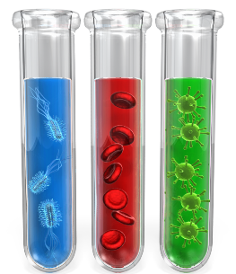
What are Microbes? Module 2, Activity #2
Students will…
…access a variety of resources to develop claims made about microbe structure.
…develop an initial model/explanation of their current understandings.

Slide 11
How Does AMR Happen? Module 2, Activity #3
Students will…
…create a visual model of the process by which bacteria become resistant to antibiotics.
…begin to develop an understanding of the role humans play in the development of AMR in microbes.

Slide 12
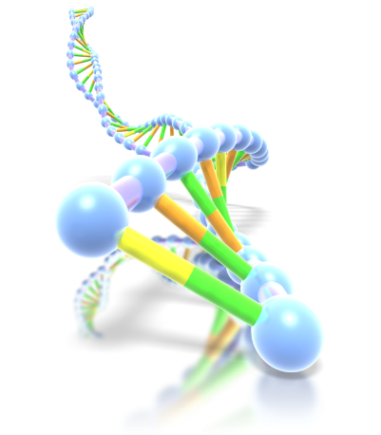
What Role Does DNA Play in the Life of a Bacterium? Module 2, Activity #4
Students will…
…obtain information from several sources in order to better make sense of the phenomenon presented.
…Incorporate their learning into a “final” model of their understanding of the anchor phenomenon

Slide 13
Module 2 Debrief
What did we learn?
You generated questions that got you thinking more about the pet store puppy problem. How will you use these questions to help guide the next steps in learning about the phenomenon?
The AMR process activity provided you with a concrete experience that reinforced the learning from the models that you generated. This inductive card sort helped you visualize how these processes, people, and places interact. While there are several “correct” ways these cards can be organized, it is important that you understand the role that humans play in the development of antimicrobial-resistant microbes.
You should have learned about the role that DNA plays in the life of bacteria; that bacteria contain circular chromosomes consisting of DNA which codes for the production of RNA and proteins. These proteins may enable them to resist antibiotics through a variety of mechanisms, allowing resistant bacteria to better survive in the presence of antimicrobial substances and drugs.

Slide 14
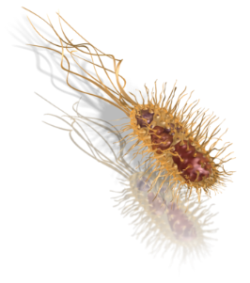
Determining Resistance in Bacterial Populations? Module 3, Activity #5
Students will…
…engage in a hands-on investigation to determine whether or not antibiotic resistance is present in a population of bacteria.
…ask new questions using the information from the investigation to continue to refine their thinking around the anchor phenomenon.

Slide 15
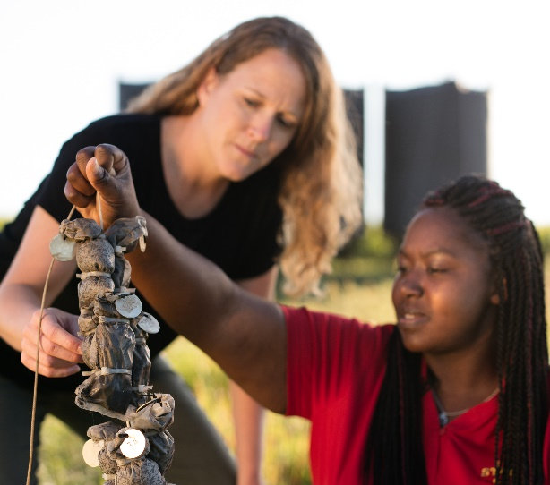
Transforming Bacterial DNA: Ampicillin Resistance Module 3, Activity #6
Students will…
…engage in a complex investigation to better understand the methods used by researchers to learn more about antibiotic resistant populations.
…discuss how bacterial DNA transformation in a lab might lead to solutions for problems arising from antibiotic resistance in agriculture
Photo credit: Iowa State University

Slide 16
One Health in Action Module 3, Activity #7
Students will…
…thoughtfully discuss the major tenets of the One Health initiative and how it can be used to mitigate the effects of antimicrobials in agriculture and beyond
…explore the antibiotic use pathways in each of the One Health domains and connections among them
…negotiate peer-to-peer conversations in order to develop consensus understanding of the One Health initiative
Photo credit: Iowa State University

Slide 17
Module 3 Debrief
What did we learn?
You should recognize that there are practical ways we can see whether or not bacteria are resistant using fairly simple lab techniques.
You discussed how bacterial DNA transformation in a lab might allow researchers to 1) better understand the mechanisms of resistance, and 2) develop potential solutions to the problem.
You should understand how people, animals, and the environment interact and coexist to support one another. The One Health initiative provides a structure in which to discuss these impacts and allows us to better see the “50,000 foot” perspective after having been “in the weeds” throughout Activities #5 and #6. Systems are complex and interconnected, but work is being done to promote healthy ecosystems and processes.

Slide 18
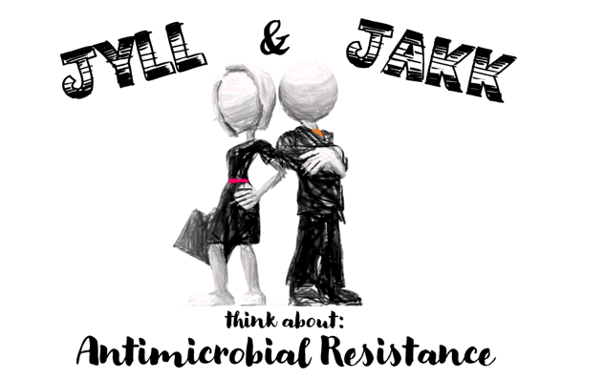
Jyll & Jakk think about Antimicrobial Resistance Module 4, Activity #8
Use what you know about antimicrobial resistance and the use of antibiotics in agriculture, to decide who you agree with more – Jyll or Jakk.
Providing evidence of your choice is important and will help you build an argument for your decision.
Photo credit: Iowa State University

Slide 19
References
https://www.news.iastate.edu/news/2016/05/04/antimicrobial
https://news.engineering.iastate.edu/2013/09/02/research-looks-to-prevent-human-exposure-to-water-borne-pathogens/
Natural Selection and the Development of Antibiotic Resistance - Middle School Sample Classroom Assessment
https://www.nextgenscience.org/sites/default/files/MS-LS_%20Antibiotic%20Resistance-Nov%202014.pdf
https://www.cdc.gov/campylobacter/outbreaks/puppies-12-19/index.html
Additional resources are noted in the curriculum booklet.

