Slide 1
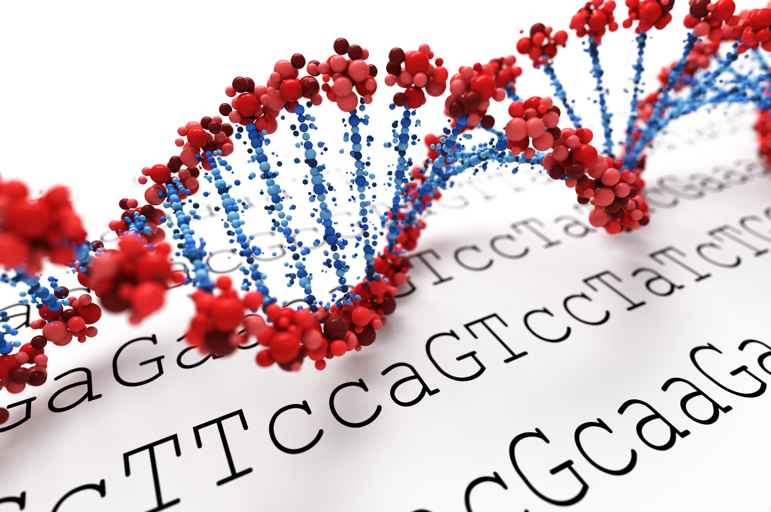
Biotechnology Outreach Education Center Office of Biotechnology
Woodchip Bioreactor
Station Activity
Updated 5/2022

Slide 2
Gel electrophoresis:
a common laboratory technique used to separate mixtures of DNA according to molecular size.

Slide 3
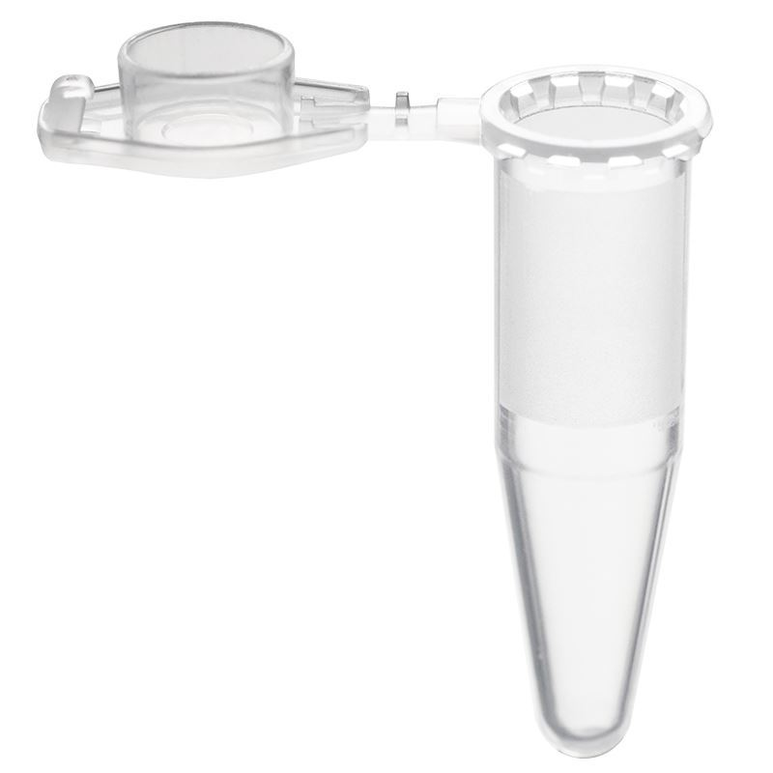
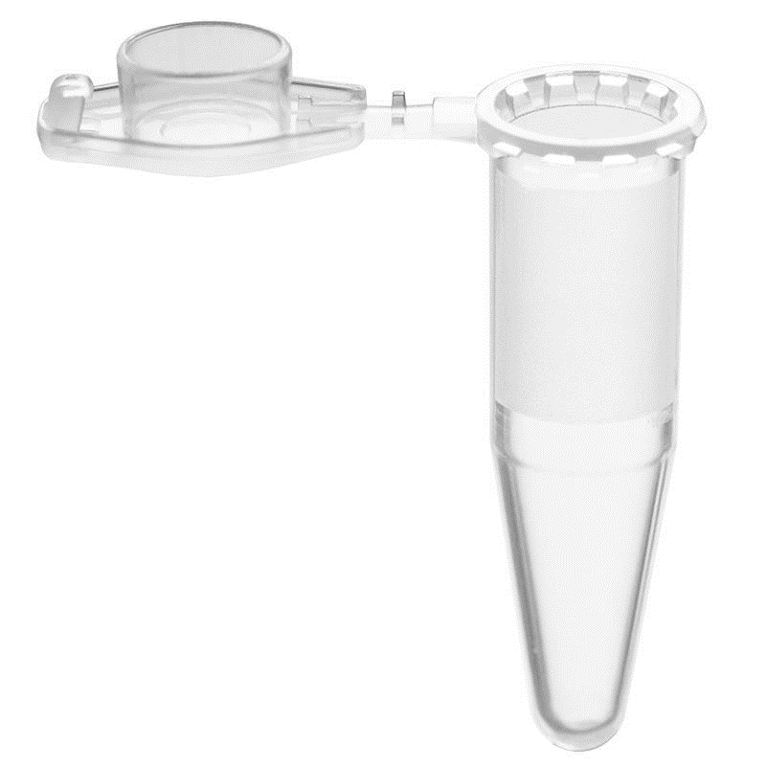
bacteria A
bacteria B
bacteria C
Image courtesy chemglass.com

Slide 4
neg
(-)
pos
(+)
gel electrophoresis

Slide 5
unknown
Image courtesy chemglass.com

Slide 6
neg
(-)
pos
(+)

Slide 7
neg
(-)
pos
(+)

Slide 8
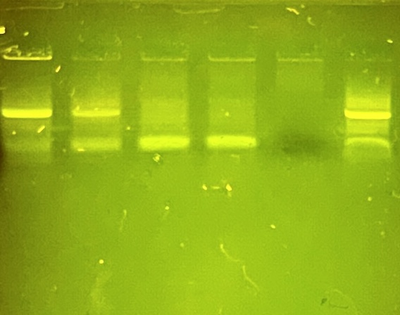
F
E
D
C
B
A

Slide 9
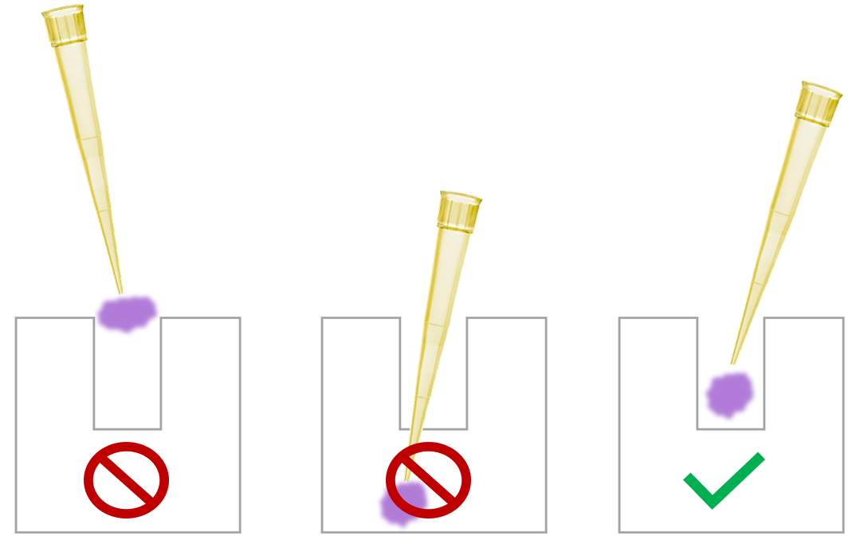

Slide 10
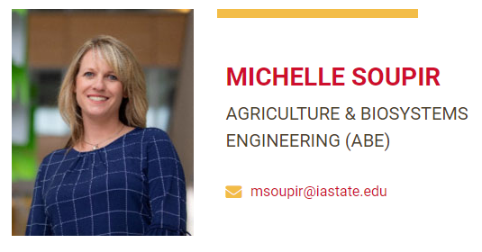
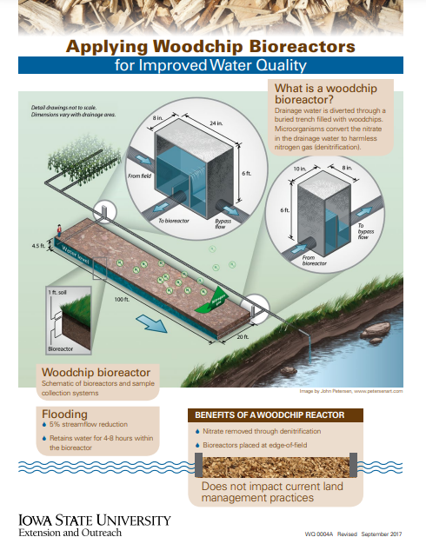

Slide 11
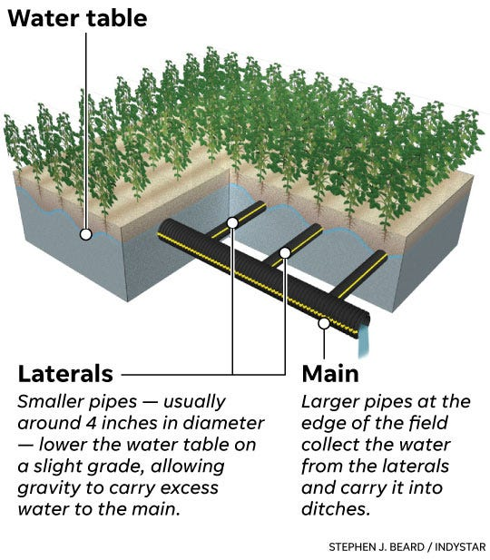
Why does Dr. Soupir we care?
1920: 22% of farmland in Iowa was tile drained
2013: increased to 66.8%
Now: more tile drainage than any other state
Increased transport of nitrates to surface water
Woodchip bioreactors are an emerging nitrate removal technology
15 to 60% removal
Use sustainable fill materials and practices
Low cost
Notes:
Point 4: blue baby syndrome, deadzone
Point 5: emerging technology for edge-of–field subsurface drainage treatment. So far, they have exhibited promising nitrate removal rates at ~15-60%

Slide 12
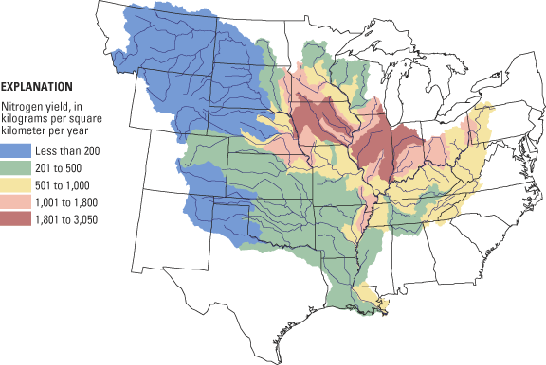
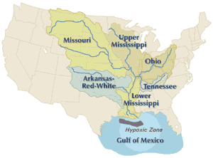
Most of Iowa is
located in the
Upper Mississippi
River Basin

Slide 13
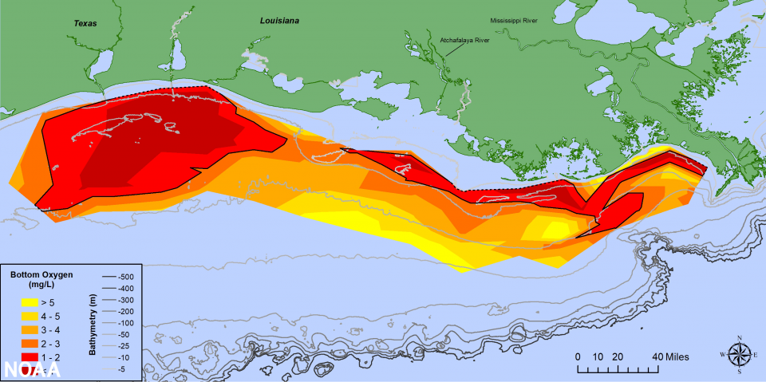
Notes:
2011 – 17,000 sq mi
2012 – 2889 sq mi (4th smallest since mapping began in 1985)
13

Slide 14
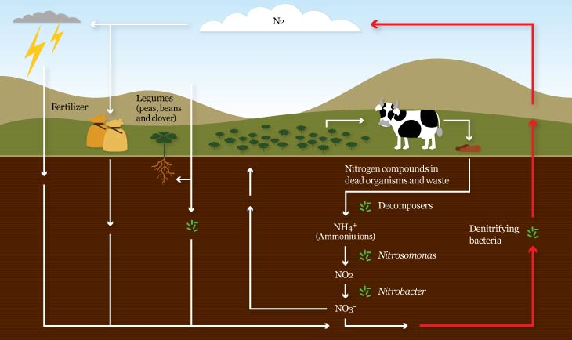
Nitrogen cycle
Nitrate inputs (NO₃)
http://www.microbiologyonline.org.uk/about-microbiology/microbes-and-the-outdoors/nitrogen-cycle

Slide 15
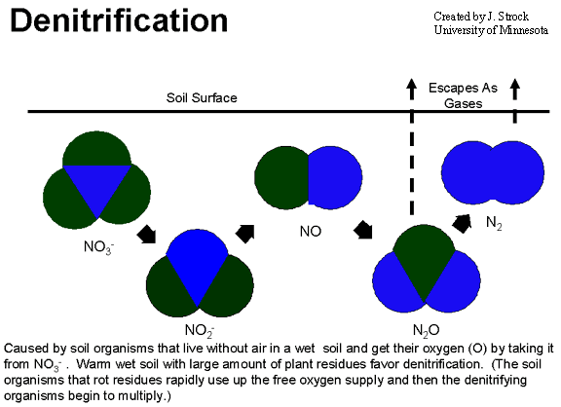
Denitrification Requirements
No (very little) oxygen
Fill materials with carbon source for food
Denitrifying bacteria
Nitrates
Notes:
Denitrification takes place under special conditions in both terrestrial and marine ecosystems. In general, it occurs where oxygen, a more energetically favorable electron acceptor, is depleted, and bacteria respire nitrate as a substitute terminal electron acceptor. Due to the high concentration of oxygen in our atmosphere denitrification only takes place in anoxic environments where oxygen consumption exceeds the oxygen supply and where sufficient quantities of nitrate are present.
Redox (reduction and oxidation) reactions include all chemical reactions in which atoms have their oxidation state changed; in general, redox reactions involve the transfer of electrons between species.
The term "redox" comes from two concepts involved with electron transfer: reduction and oxidation. It can be explained in simple terms:
Oxidation is the loss of electrons or an increase in oxidation state by a molecule, atom, or ion.
Reduction is the gain of electrons or a decrease in oxidation state by a molecule, atom, or ion.

Slide 16
Bioreactor Design
Advantages:
Does not necessitate taking land out of production, can be installed below filter strips at the edge of the field.
Begins removing nitrate immediately upon completion with the first water flow.
Can be targeted for placement to optimize impact.
Is readily accepted by producers.
Can be installed in landscapes in which wetlands cannot be built.

Slide 17
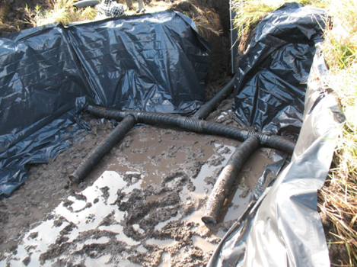
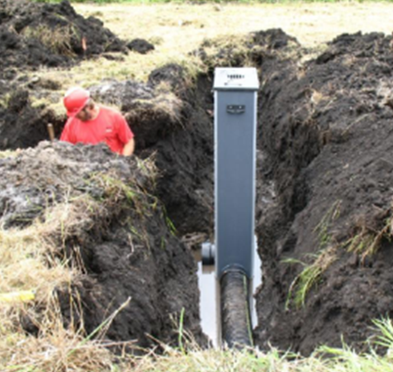
Bioreactor Installation
Install control structures
Excavate trench
Fill with woodchips
Cover with soil
Seed
http://www.iasoybeans.com/environment/programs-initiatives/programs/bioreactors/demonstration
Photo source: Sutphin and Kult, Iowa Soybean Association
Notes:
2 minute video- Iowa Soybean Association: Bioreactor (shows installation, describes number of reactors ISA has been involved with and how long)

Slide 18
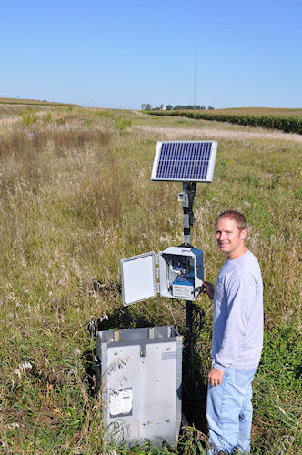
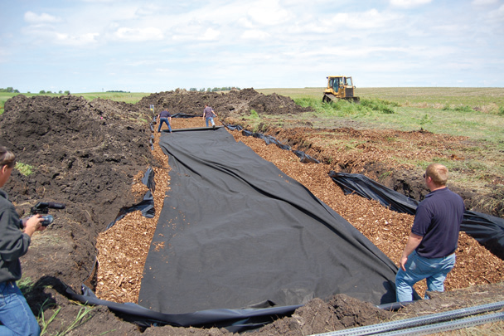
Bioreactor Installation
Source: Keegan Kult, Iowa Soybean Association, Greene County bioreactor installation

Slide 19
So, what’s the secret?
Researchers closely monitor bioreactor effectiveness and efficiency
When one bioreactor seems to “work better” than others, questions are asked:
How is this bioreactor different than others?
What fill material is being used?
Are denitrifying bacteria present?

Slide 20
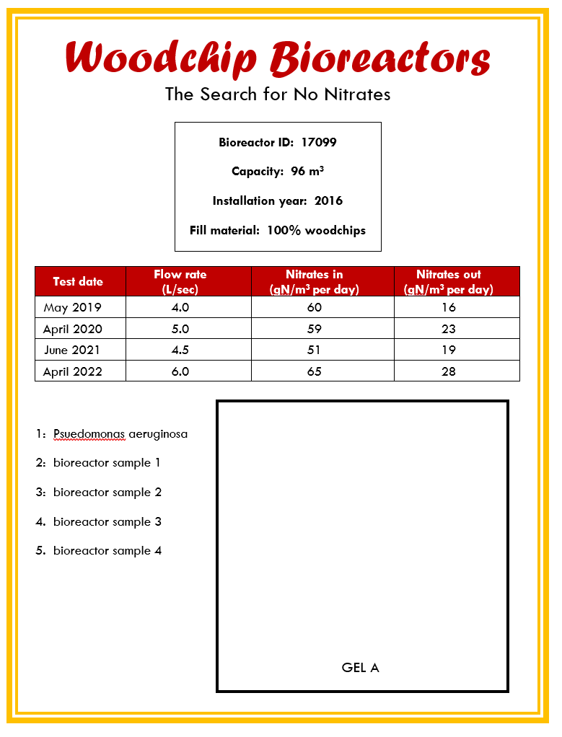
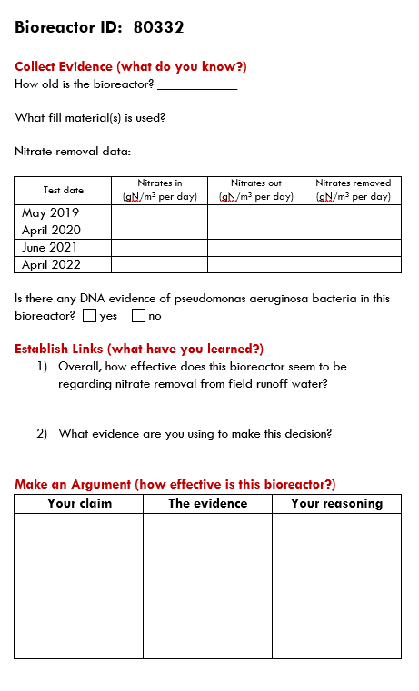

Slide 21
Next steps?
Can we collect data from even more bioreactors around the state?
If one bioreactor works better than the others, what can that teach us?
Researchers at Iowa State University are making bioreactors as efficient as possible.

Slide 22
Thank
You!

